Slide 2
Module 13 Topics
15.8 Displaying Images
JavaFX Components
Lists
Combo Boxes
Mnemonics and Tool Tips
Menus
Text Areas
Fonts
Sliders
Handling Mouse Events
15.9 Timeline Animation
AnimationTimer Objects
Playing Audio

Slide 3
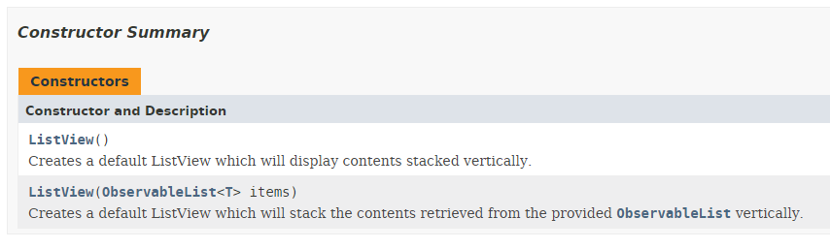
Lists
A list is a component that displays a list of items and allows the user to select items from the list.
The ListView component is used for creating lists.
There are two ways to create a ListView

Slide 4
Lists
Create an empty ListView and fill in data afterwards
ListView<String> list = new ListView();
ObservableList<String> names = FXCollections.observableArrayList("Bill", "Geri", "Greg", "Jean", "Kirk", "Phillip", "Susan");
List.setItems(items);

Slide 5
Lists
When an instance of the ListView class is created, an observableArrayList of objects can be passed to the constructor.
ListView (ObservableArrayList<String> array)
The ListView component uses the ObservableArrayList to create the list of items.
ObservableList<String> names = FXCollections.observableArrayList("Bill", "Geri", "Greg", "Jean", "Kirk", "Phillip", "Susan“);
ListView<String> nameList = new ListView(names);

Slide 6
List Selection Modes
The ListView component can operate in either of the following selection modes:
Single Selection Mode - Only one item can be selected at a time.
This is the default selection mode.
Multiple Selection Mode - Allows for one or more contiguous range of indices to be selected at a time.
nameList.getSelectionModel().
setSelectionMode(SelectionMode.MULTIPLE)

Slide 7
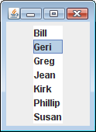
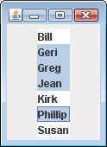
List Selection Modes
Single selection mode allows
only one item to be selected
at a time.
Multiple selection mode allows multiple items to be selected with no restrictions.

Slide 8
List Selection Modes
You change a ListView component’s selection mode with the setSelectionMode method.
The method accepts an int argument that determines the selection mode:
SelectionMode.SINGLE
SelectionMode.MULTIPLE
Example:
nameList.getSelectionModel().setSelectionMode(
SelectionMode.MULITPLE);

Slide 9
List Events
When an item in a ListView object is selected it generates an event.
The event is handled by an instance of a change listener class, which must meet the following requirements:
It must implement the ChangeListener interface.
It must have a method named changed.
nameList.getSelectionModel().selectedItemProperty().addListener(
new ChangeListener<String>() {
public void changed(ObservableValue<? extends String> ov, String old_val, String new_val) {
//Actions for the listener
}
});

Slide 10
List Events
When the ListView component generates an event:
it automatically executes the changed method of the change listener object

Slide 11
Retrieving Selected Items
You may use:
getSelectedValue or
getSelectedIndex
to determine which item in a list is currently selected.
getSelectedValue returns a reference to the item that is currently selected.
String selectedName;
selectedName = nameList.getSelectionModel().getSelectedValue();
If no item in the list is selected, the method returns null.

Slide 12
Retrieving Selected Items
The getSelectedIndex method returns the index of the selected item, or –1 if no item is selected.
Internally, the items that are stored in a list are numbered (similar to an array).
Each item’s number is called its index.
The first item has the index 0.
You can use the index of the selected item to retrieve the item from an array.

Slide 13
Retrieving Selected Items
This code could be used to determine the selected item:
int index;
String selectedName;
index = nameList.getSelectedModel().getSelectedIndex();

Slide 14
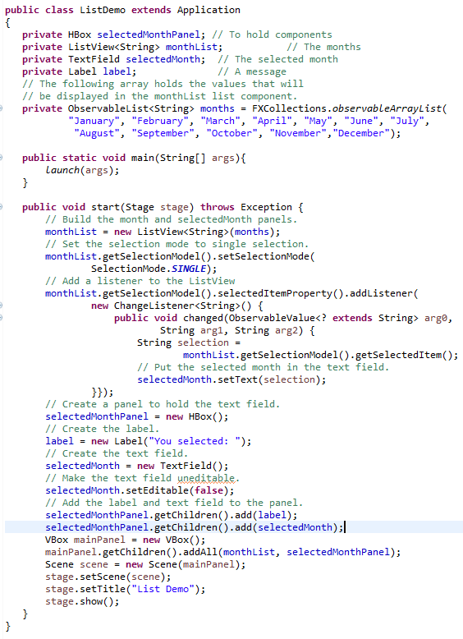
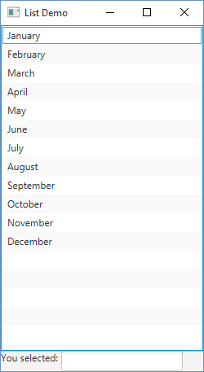

Slide 15
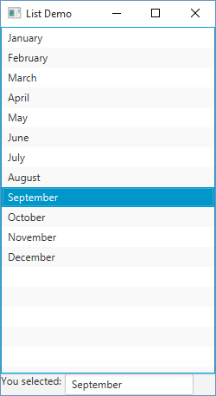
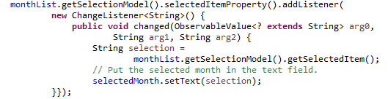

Slide 16
Adding A Scroll Bar To a List
By default, a list component is large enough to display all of the items it contains.
Sometimes a list component contains too many items to be displayed at once.
Most GUI applications display a scroll bar on list components that contain a large number of items.
List components do not automatically display a scroll bar.

Slide 17
Adding A Scroll Bar To a List
Create a scroll pane object and add the list component to it.
A scroll pane object is a container that displays scroll bars on any component it contains.
The ScrollPane class to create a scroll pane object.
We pass the object that we wish to add to the scroll pane as an argument to the ScrollPane constructor.
ScrollPane pane = new ScrollPane();
pane.setContent(nameList);

Slide 18
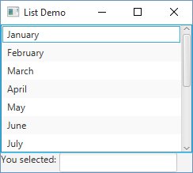
Adding A Scroll Bar To a List
Add the scroll pane object to any other containers that are necessary for the GUI.
Hbox mainBox = new HBox();
mainBox.getChildren().add(scrollPane);

Slide 19
Multiple Selection Mode
The user holds down the Ctrl key while clicking on an item
it selects the item without deselecting other items.
The getSelectedItems method returns a read only ObservableList of objects containing the items that are selected.
The getSelectedIndices method returns an read only ObservableList of Integers containing the indices of the selected items.

Slide 20
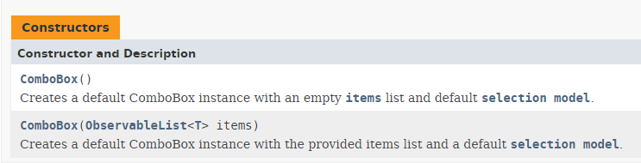
Combo Boxes
A combo box presents a drop-down list of items that the user may select from.
The ComboBox class is used to create a combo box.
Pass an ObservableList of objects that are to be displayed as the items in the drop-down list to the constructor.
ObservableList<String> names = FXCollections.observableArrayList("Bill", "Geri", "Greg", "Jean", "Kirk", "Phillip", "Susan“);
ComboBox nameBox = new ComboBox(names);

Slide 21

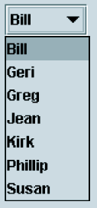
Combo Boxes
When displayed, the combo box created by this code will initially appear as the button:
The button displays the item that is currently selected.
The first item in the list is automatically selected when the combo box is displayed.
When the user clicks on the button, the drop-down list appears and the user may select another item.

Slide 22
Combo Boxes
ComboBox comboBox = new ComboBox();
comboBox.setItems(options);
To add more items to the combobox of items with new values:
comboBox.getItems().addAll(“4”, “5”, “6”);
To restrict the number of visible rows in the dropdown list:
comboBox.setVisibleRowCount(3);

Slide 23
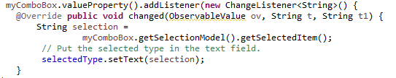
Combo Box Events
When an item in a ComboBox object is selected, it generates an event.
The event is handled by an instance of a change listener class, which must meet the following requirements:
It must implement the ChangeListener interface.
It must have a method named changed.

Slide 24
Retrieving Selected Items
There are two methods in the ComboBox class that can be used to determine which item in a list is currently selected:
getSelectedItem
getSelectedIndex
The getSelectedItem method returns a reference to the item that is currently selected.

Slide 25
Retrieving Selected Items
The getSelectedIndex method returns the index of the selected item.

Slide 26
Editable Combo Boxes
There are two types of combo boxes:
uneditable – allows the user to only select items from its list.
editable – combines a text field and a list.
It allows the selection of items from the list
allows the user to type input into the text field
The setEditable method sets the edit mode for the component.
comboBox.setEditable(true);

Slide 27
Editable Combo Boxes
An editable combo box appears as a text field with a small button displaying an arrow joining it.
When the user clicks on the button, the drop-down list appears as shown in the center of the figure.
The user may:
select an item from the list.
type a value into the text field.
The user is not restricted to the values that appear in the list, and may type any input into the text field.

Slide 28

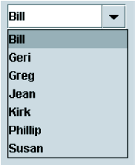

Editable Combo Boxes
Note that Sharon is not in the list.

Slide 29
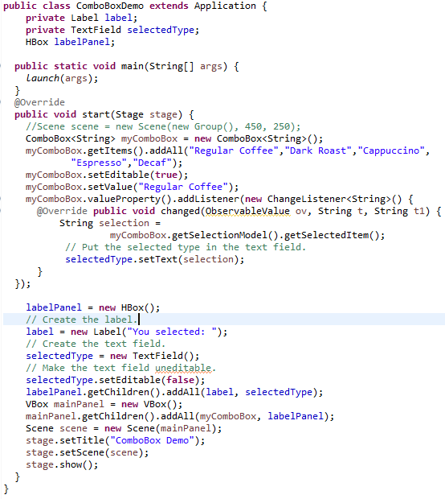
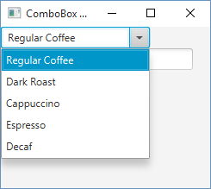
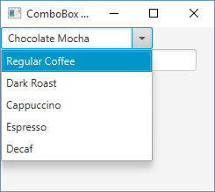
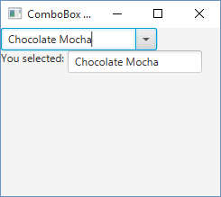
User types in new text

Slide 30
Displaying Images in JavaFX
Using images requires the use of the Image and ImageView classes
Image is used to create an in-memory representation of an image.
The image may be in an InputStream object, or may be in a location online (specified by a URL string), or on the local file system (specified by a pathname string)
An Image object is not a JavaFX node, so cannot be displayed on the screen
ImageView is a subclass of Node: it is used to wrap Image objects for screen display

Slide 31
The Image Class and ImageView Classes
Image(InputStream stream): This constructor creates an image from an input stream, for example
new Image(new FileInputStream(“tiger.jpg”);
Image(String location): Creates an image by fetching content from a local file system location or from a URL, for example
new Image(“c:\\temp\\images\\tiger.jpg”);
ImageView(Image image): Creates an ImageView object by wrapping an in-memory Image
ImageView(String location): Fetches content from the given location, internally creates an Image object, and wraps it.
ImageView(): creates an ImageView object without an Image. The image can be set with the setImage(Image im) method.

Slide 32
Displaying Images in JavaFX
To display an image, create an instance of the ImageView class, which reads the image file.
The constructor accepts the name of an image file.
The supported file types are JPEG, GIF, and PNG.
The name can also contain path information (URL).

Slide 33
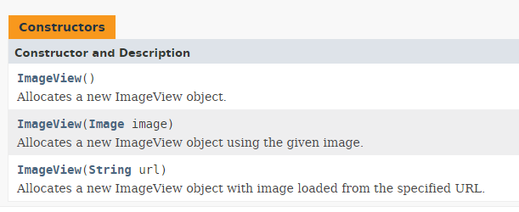
Class ImageView
ImageView image = new ImageView("Smiley.gif");

Slide 34
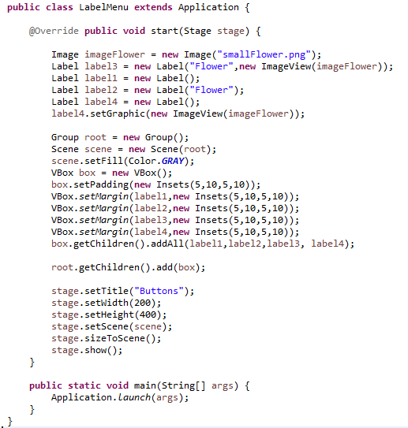
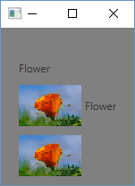

Slide 35
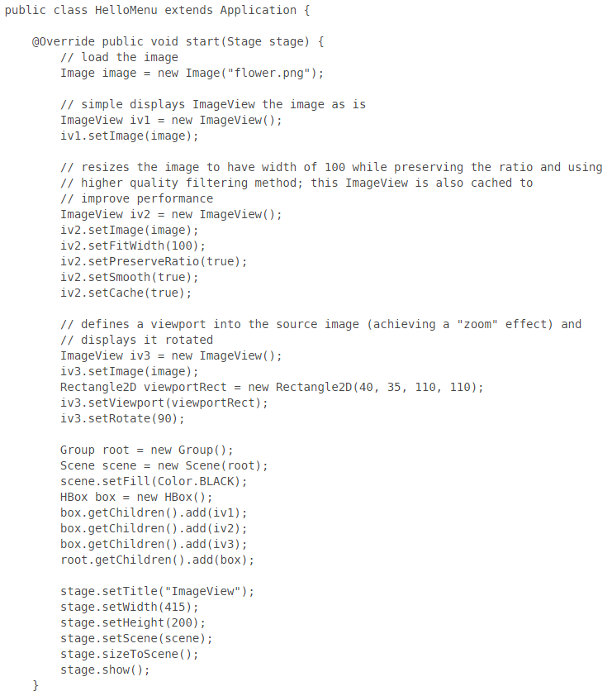
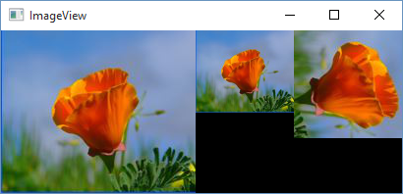

Slide 36
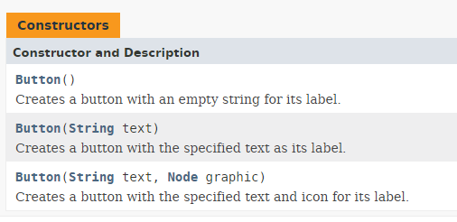
Displaying Images on Buttons

Slide 37
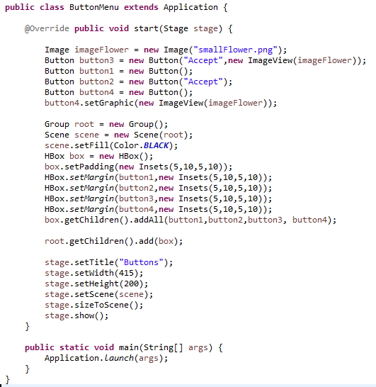
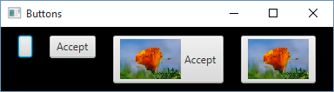

Slide 38
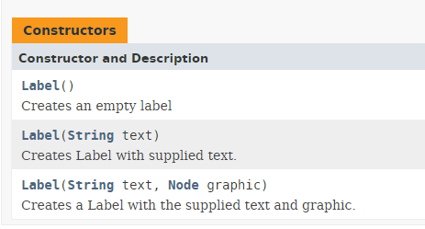
Displaying Images on a Label

Slide 39
Mnemonics
A mnemonic is a key that you press in combination with the Alt key to quickly access a component.
These are sometimes referred to as hot keys.
A mnemonic is setup for a button by first calling the setMnemonicParsing(true) method for the button
Then, when you set the text to be displayed on the button, prefix the character to be used as the mnemonic with an underline. For example, to display the mnemonic “File” set the text to “_File”.

Slide 40


Mnemonics
In some versions of JavaFX, the underline for the mnemonic does show until the user presses the Alt key.

Slide 41
Tool Tips
A tool tip is text that is displayed in a small box when the mouse is held over a component.
The box usually gives a short description of what the component does.
Most GUI applications use tool tips as concise help to the user.

Slide 42
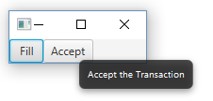
Tool Tips
Assign a tool tip to a component with the setToolTip method.
button2.setTooltip(new Tooltip("Accept the Transaction"));

Slide 43
Dialog Boxes
Recall that a dialog box is a small window that "pops up" to interact with the user for a brief, specific purpose
The JOptionPane class makes it easy to create dialog boxes for presenting information, confirming an action, or accepting an input value
Let's now look at another class that lets us create a specialized dialog box

Slide 44
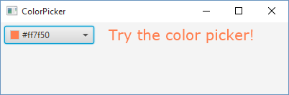
Color Picker
A color picker is a specialized dialog box that allows the user to select a color from a predefined palette of colors.
final ColorPicker colorPicker = new ColorPicker();
colorPicker.setValue(Color.CORAL);
final Text text = new Text("Try the color picker!");
text.setFont(Font.font ("Verdana", 20));
text.setFill(colorPicker.getValue());

Slide 45
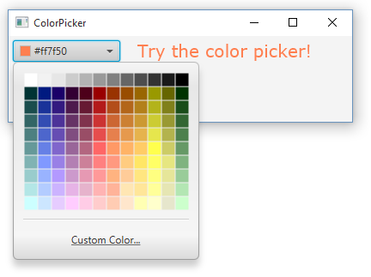
Color Picker
By clicking the Combox arrow – the Color Palette appears

Slide 46
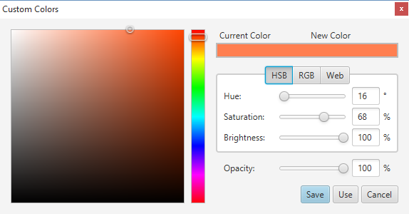
Color Picker
By clicking Custom Color …
By clicking the HSB tab you can select a color by specifying its hue, saturation, and brightness.
By clicking the RGB tab you can select a color by specifying its red, green, and blue components.

Slide 47
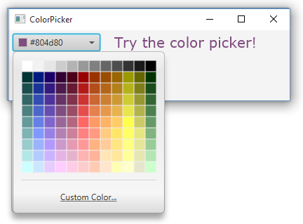
Color Picker
final ColorPicker colorPicker = new ColorPicker();
colorPicker.setValue(Color.CORAL);
final Text text = new Text("Try the color picker!");
text.setFont(Font.font ("Verdana", 20));
text.setFill(colorPicker.getValue());
colorPicker.setOnAction(new EventHandler() {
public void handle(Event t) {
text.setFill(colorPicker.getValue());
}
});
box.getChildren().addAll(colorPicker, text);

Slide 48
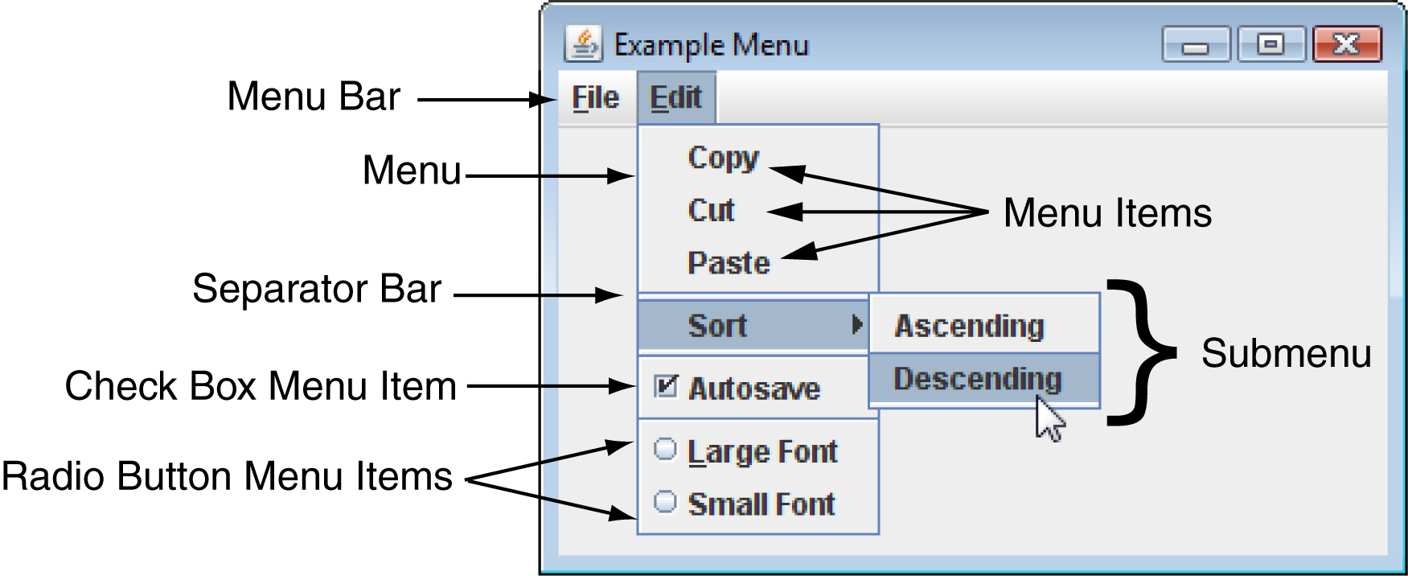
Menus
A menu system is a collection of commands organized in one or more drop-down menus.

Slide 49
Components of A Menu System
A menu system commonly consists of:
Menu Bar – A menu bar lists the names of one or menus.
Menu – A menu is a drop-down list of menu items.
Menu Item – A menu item can be selected by the user.
Check box menu item – A check box menu item appears with a small box beside it.
The item may be selected or deselected.
Radio button menu item – A radio button menu item may be selected or deselected.
Submenu – A menu within a menu is called a submenu.
Separator bar – A separator bar is a horizontal bar used to separate groups of items on a menu.

Slide 50
Menu Classes
A menu system is constructed with the following classes:
MenuBar – Used to create a menu bar.
A MenuBar object can contain Menu components.
Menu – Used to create a menu. A Menu component can contain:
MenuItem, CheckMenuItem, and RadioMenuItem components,
as well as other Menu components.
A submenu is a Menu component that is inside another Menu component.
MenuItem – Used to create a regular menu item.
A MenuItem component generates an action event when selected.

Slide 51
Menu Classes
CheckMenuItem – Used to create a check box menu item.
The class’s isSelected method returns true if the item is selected, or false otherwise.
A CheckMenuItem component generates an action event when selected.
RadioMenuItem – Used to create a radio button menu item.
RadioMenuItem components can be grouped together in a ToggleGroup object so that only one of them can be selected at a time.
The class’s isSelected method returns true if the item is selected, or false otherwise.
A RadioMenuItem component generates an action event when selected.

Slide 52
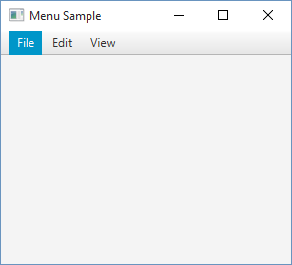
Menu Example
public void start(Stage stage) {
stage.setTitle("Menu Sample");
Scene scene = new Scene(new VBox(), 400, 350);
scene.setFill(Color.OLDLACE);
MenuBar menuBar = new MenuBar();
// --- Menu File
Menu menuFile = new Menu("File");
// --- Menu Edit
Menu menuEdit = new Menu("Edit");
// --- Menu View
Menu menuView = new Menu("View");
menuBar.getMenus().addAll(menuFile, menuEdit, menuView);
((VBox) scene.getRoot()).getChildren().addAll(menuBar);
stage.setScene(scene);
stage.show();
}

Slide 53
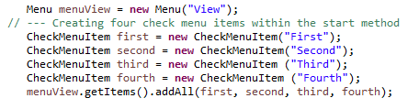
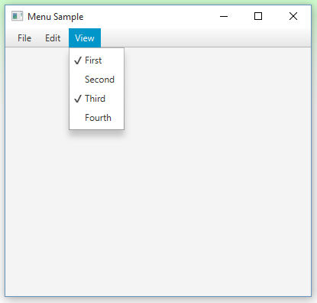

Slide 54
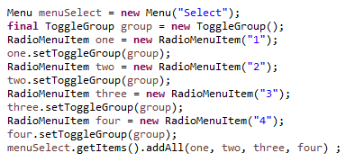
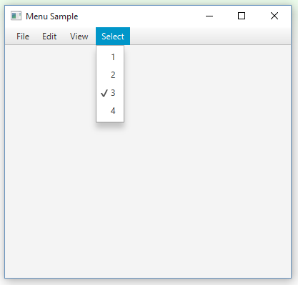
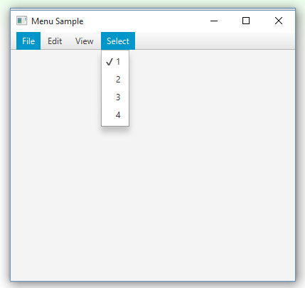
With ToggleGroup – only 1 selected at a time

Slide 55
Text Areas
The TextField class is used to create text fields.
A text field is a component that allows the user to enter a single line of text.
A text area is like a text field that can accept multiple lines of input.
You use the TextArea class to create a text area.
The general format of two of the class’s constructors:
TextArea()
TextArea(String text)

Slide 56
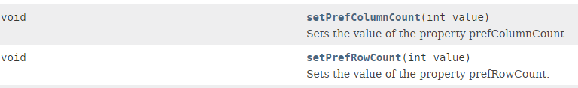
Text Areas
To set the number of rows and columns in the text area.

Slide 57
Text Areas
The TextArea class provides the getText and setText methods for getting and setting the text.
TextArea textInput = new TextArea();
String userText = textInput.getText();
textInput.setText("Modified: " + userText);
TextArea components do not automatically display scroll bars.
You must add a text area to a scroll pane.
TextArea textInput = TextArea();
ScrollPane pane = new ScrollPane();
pane.setContent(textInput);

Slide 58
Text Areas
By default, TextArea components do not perform line wrapping.
To enable line wrapping:
textInput.setWrapText(true);

Slide 59
Fonts
Components display according to their font characteristics:
font – the name of the typeface
style – can be plain, bold, and/or italic
size – size of the text in points.
A component’s setFont method will change the appearance of the text in the component:
setFont (Font appearance)
A Font constructor takes three parameters:
Font(String fontName, int style, int size)

Slide 60
Fonts
Java guarantees that you will have the fonts:
Dialog, DialogInput, Monospaced, SansSerif, and Serif.
There are three font styles:
Font.PLAIN, Font.BOLD, and Font.ITALIC.
Example:
label.setFont(new Font(
"Serif", Font.BOLD, 24));
Font styles can be combined adding them.
label.setFont(new Font(
"Serif", Font.BOLD + Font.ITALIC, 24));

Slide 61
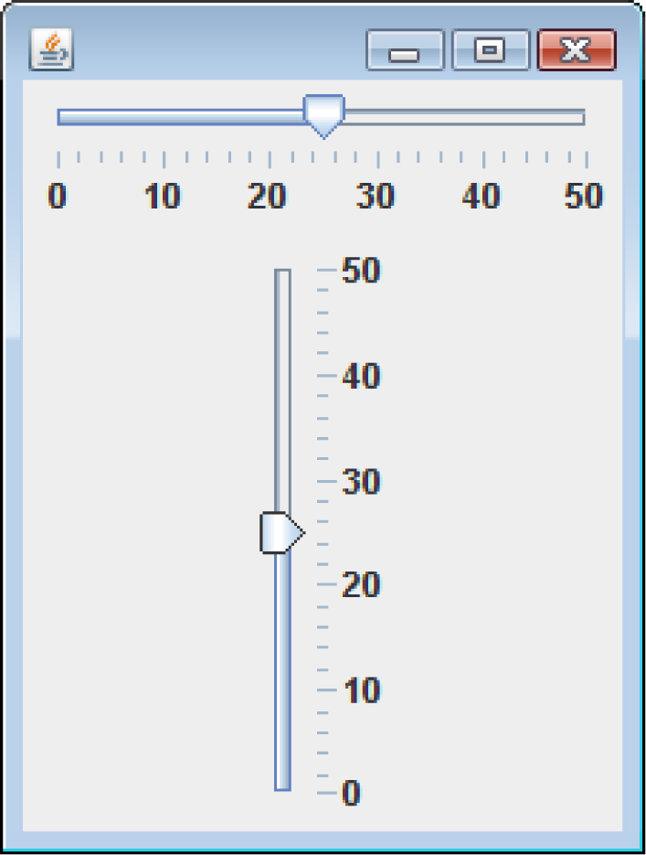
Sliders
A slider is a component that allows the user to graphically adjust a number within a range.
Sliders are created from the Slider class.
They display an image of a “slider knob” that can be dragged along a track.

Slide 62
Sliders
A slider is designed to represent a range of numeric values.
As the user moves the knob along the track, the numeric value is adjusted accordingly.
Between the minimum and maximum values, major tick marks are displayed with a label indicating the value at that tick mark.
Between the major tick marks are minor tick marks.

Slide 63
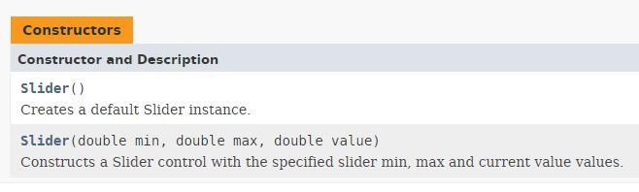
Sliders
The Slider constructors:
To Set the orientation:
setOrientation(Orientation.HORIZONTAL)
setOrientation(Orientation.HORIZONTAL)

Slide 64
Sliders
Set the major and minor tick mark spacing with:
setMajorTickSpacing
setMinorTickSpacing
Example:
slider1.setMajorTickSpacing(10);
slider1.setMinorTickSpacing(2);

Slide 65
Sliders
Display tick marks by calling:
setShowTickMarks
slider1.setShowTickMarks(true);
Display numeric labels on the slider by calling:
setShowTickLabels
slider1.setShowTickLabels(true);

Slide 66
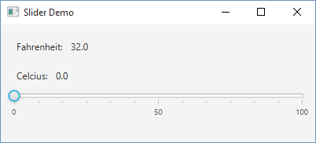
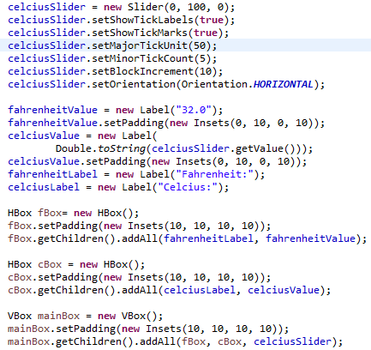

Slide 67
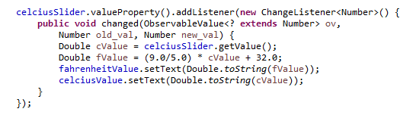
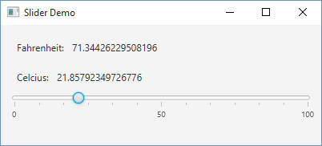

Slide 68
Handling Mouse Events
The mouse generates several types of events:
Mouse Events
MousePressed
MouseReleased
MouseClicked
MouseDragged
MouseMoved
MouseEntered
MouseExited

Slide 69
Mouse Events
import javafx.application.Application;
import javafx.event.EventHandler;
import javafx.scene.*;
import javafx.scene.control.Button;
import javafx.scene.input.MouseEvent;
import javafx.stage.Stage;
public class Main extends Application {
public static void main(String[] args) {
Application.launch(args);
}
@Override
public void start(Stage primaryStage) {
Group root = new Group();
Scene scene = new Scene(root, 300, 250);
Button btn = new Button();
btn.setText("Hello World");
btn.setOnMouseEntered(new EventHandler<MouseEvent>() {
public void handle(MouseEvent me) {
System.out.println("Mouse entered");
}
});
btn.setOnMouseExited(new EventHandler<MouseEvent>() {
public void handle(MouseEvent me) {
System.out.println("Mouse exited");
}
});
btn.setOnMousePressed(new EventHandler<MouseEvent>() {
public void handle(MouseEvent me) {
System.out.println("Mouse pressed");
}
});
root.getChildren().add(btn);
primaryStage.setScene(scene);
primaryStage.show();
}
}

Slide 70
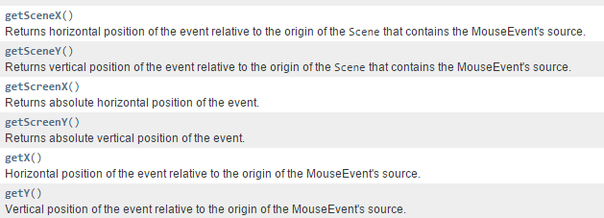
Mouse Event Methods
The MouseEvent object contains data about the mouse event.
getX and getY are two common methods of the MouseEvent class.
They return the X and Y coordinates of the mouse cursor when the event occurs.

Slide 71
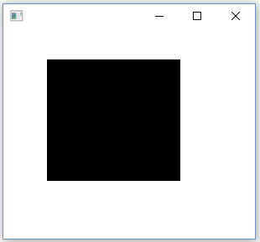
public class DrawBoxes extends Application {
private static double currentX = 0;
private static double currentY = 0;
private static double width = 0;
private static double height = 0;
private Rectangle box, newbox;
public static void main(String[] args) {
Application.launch(args);
}
public void start(Stage primaryStage) {
Pane pane = new Pane();
box = new Rectangle();
Scene scene = new Scene(pane, 300, 250);
scene.setOnMousePressed(new EventHandler<MouseEvent>() {
public void handle(MouseEvent me) {
currentX = me.getX();
currentY = me.getY();
}
});
scene.setOnMouseDragged(new EventHandler<MouseEvent>() {
public void handle(MouseEvent event) {
width = event.getX() - currentX;
height = event.getY() - currentY;
newbox = new Rectangle(currentX, currentY, width, height);
pane.getChildren().remove(box);
pane.getChildren().add(newbox);
box = newbox;
}
});
primaryStage.setScene(scene);
primaryStage.show();
}
}
Where mouse was pressed, sets up
beginning X and Y
Where mouse was dragged to,
creates box and adds to pane

Slide 72
Timeline Animation
A Timeline animation is a process for keying changes in a collection of object properties to the passage of time.
There are times when we want a program to:
change the values of certain variables, and/or
call a previously designated method
at the expiration of some interval of time.
Timeline animation uses the concept of key frames. A key frame is used to specify, for each object property P that is being updated by the timeline, a target value for P at a certain point in time. These target values are referred to a key values of the key frame. Thus a key value is also called an end value. A timeline animation is defined by a sequence of key frames.

Slide 73
Timeline Animation
To create an animation, you must
determine the duration of the animation – this is how long the animation will run.
Specify key frames for key points along the duration
The animation will then interpolate between the supplied key frames and compute enough frames so that there is a frame to display ever 1/30th of a second.

Slide 74
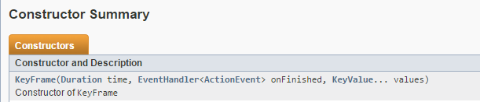
The KeyFrame class is used to represent key frames.
Duration for the key frame
Event handler to be executed when the key frame is reached
List of key values

Slide 75
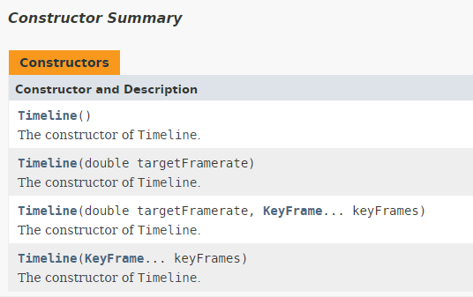
A Timeline is just a list of key frames

Slide 76
The Timeline class is a subclass of the Animation class and inherits the following methods:
void playFromStart() – play animation from beginning
void play() – play animation from its current position
void pause() – play an animation that is already playing
void stop() – stop an animation and reset to beginning
void setCycleCount(int count) – repeats animation
setCycleCount(Animation.INDEFINITE) - causes the
animation to be repeated indefinitely until stop() is called

Slide 77
Write a program that displays a counter that goes from 0 to 15, incrementing at one second intervals, and then stops.
Label – initialize to “0”
Use Timeline with a single key frame.
Duration of 1 second – 1000 milliseconds
Event handler – reads the number from label, increments it, and updates the label
Cycle count of 15

Slide 78
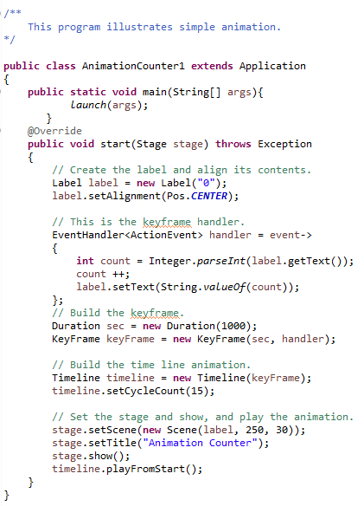





Slide 79
AnimationTimer Objects
AnimationTimer objects automatically generate action events at regular time intervals.
This is useful when you want a program to:
perform an operation at certain times or
after an amount of time has passed.
AnimatinTimer objects are created from the AnimationTimer class.
The class AnimationTimer allows the creation of a timer, that is called in each frame while it is active.

Slide 80
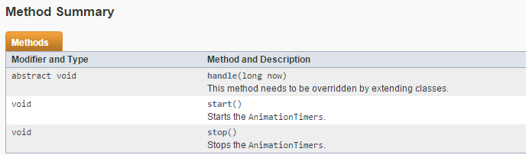
AnimationTimer Objects
The general format of the AnimationTimer class’s constructor:
AnimationTimer()
An extending class has to override the method handle(long) which will be called in every frame.
The methods start() and stop() start and stop the timer.

Slide 81

public class BounceMain extends Application {
private final int MAXIMUM_Y = 230;
private final int MAXIMUM_X = 300;
private Rectangle box, newbox;
private int x,y, moveX, moveY;
public static void main(String[] args) {
Application.launch(args);
}
public void start(Stage primaryStage) {
Pane pane = new Pane();
Scene scene = new Scene(pane, 320, 250);
box = new Rectangle(20, 20,20,20);
x = 0; y = 0;
moveX = moveY = 2;
new AnimationTimer() {
public void handle(long now) {
x += moveX;
y += moveY;
if(x <=0 || x>= MAXIMUM_X)
moveX *= -1;
if(y <= 0 || y >= MAXIMUM_Y)
moveY *= -1;
newbox = new Rectangle(x, y, 20,20);
pane.getChildren().remove(box);
pane.getChildren().add(newbox);
box = newbox;
}
}.start();
primaryStage.setScene(scene);
primaryStage.show();
}
}

Slide 82
Playing Audio
Java programs can play audio that is stored in a variety of sound file formats.
MP3;
AIFF containing uncompressed PCM;
WAV containing uncompressed PCM;
MPEG-4 multimedia container with Advanced Audio Coding (AAC) audio.
The Media class represents a media resource. It is instantiated from the string form of a source URI. Information about the media such as duration, metadata, tracks and video resolution may be obtained from a Media instance.

Slide 83
Playing Audio
The MediaPlayer class provides the controls for playing media. It is used in combination with the Media and the MediaView classes to display and control the media playback.
MediaPlayer does not include any visual elements so it must be used with MediaView to view any video track which may be present.
MediaPlayer provides the pause(), play(), stop() and see() controls as well as the rate and autoPlay properties which apply to all types of media. It also provides the balance, mute and volume properties which control audio playback.
The MediaView class provided a view of Media being played by the MediaPlayer

Slide 84
import java.io.File;
import javafx.application.Application;
import javafx.scene.media.Media;
import javafx.scene.media.MediaPlayer;
import javafx.scene.media.MediaView;
import javafx.stage.FileChooser;
import javafx.stage.Stage;
public class AudioMain extends Application {
public static void main(String[] args) {
launch(args);
}
public void start(Stage primaryStage) {
FileChooser fc = new FileChooser();
File file = fc.showOpenDialog(null);
String path = file.getAbsolutePath();
path = path.replace("\\", "/");
Media media = new Media(new File(path).toURI().toString());
mediaPlayer = new MediaPlayer(media);
mediaPlayer.setAutoPlay(true);
MediaView mediaView = new MediaView(mediaPlayer);
mediaView.setMediaPlayer(mediaPlayer);
primaryStage.setTitle("Audio Player 1");
primaryStage.setWidth(200);
primaryStage.setHeight(200);
primaryStage.show();
}
}

